Slide 1
Tsugi At Scale

Slide 2
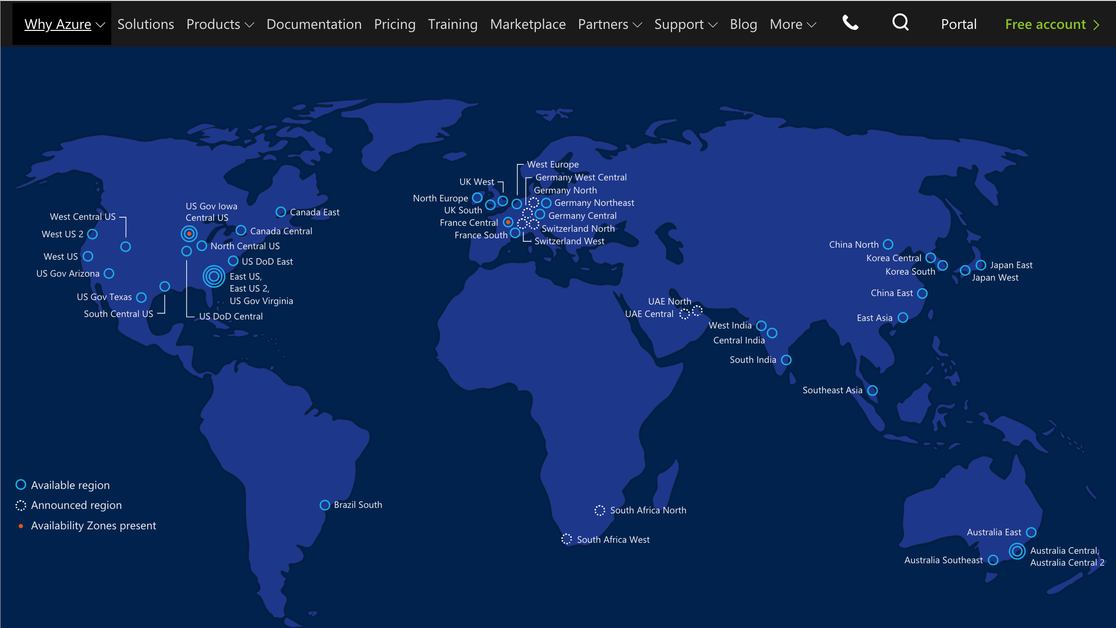

Slide 3
C
l
o
u
d
f
l
a
r
e
Amazon
F
I
r
e
w
a
l
l
Application
Load
Balancer
EC2
Aurora
EC2
EFS
…
EC2
DynamoDB
Google
Kubernetes
CloudSQL
Ingress
Service
Load
Balancer
Docker
NFS
…
Docker
DataStore
Demo at Workshop

Slide 4
Learning Experiences
www.learnxp.com

Slide 5

… with North American and European Higher Education IT, pursuing an "outsource first" / "cloud first" approach as "best practice", it is imperative that new open source project include a commercial cloud provider for the software early on...
- Charles Severance, 9-May-2015

Slide 6
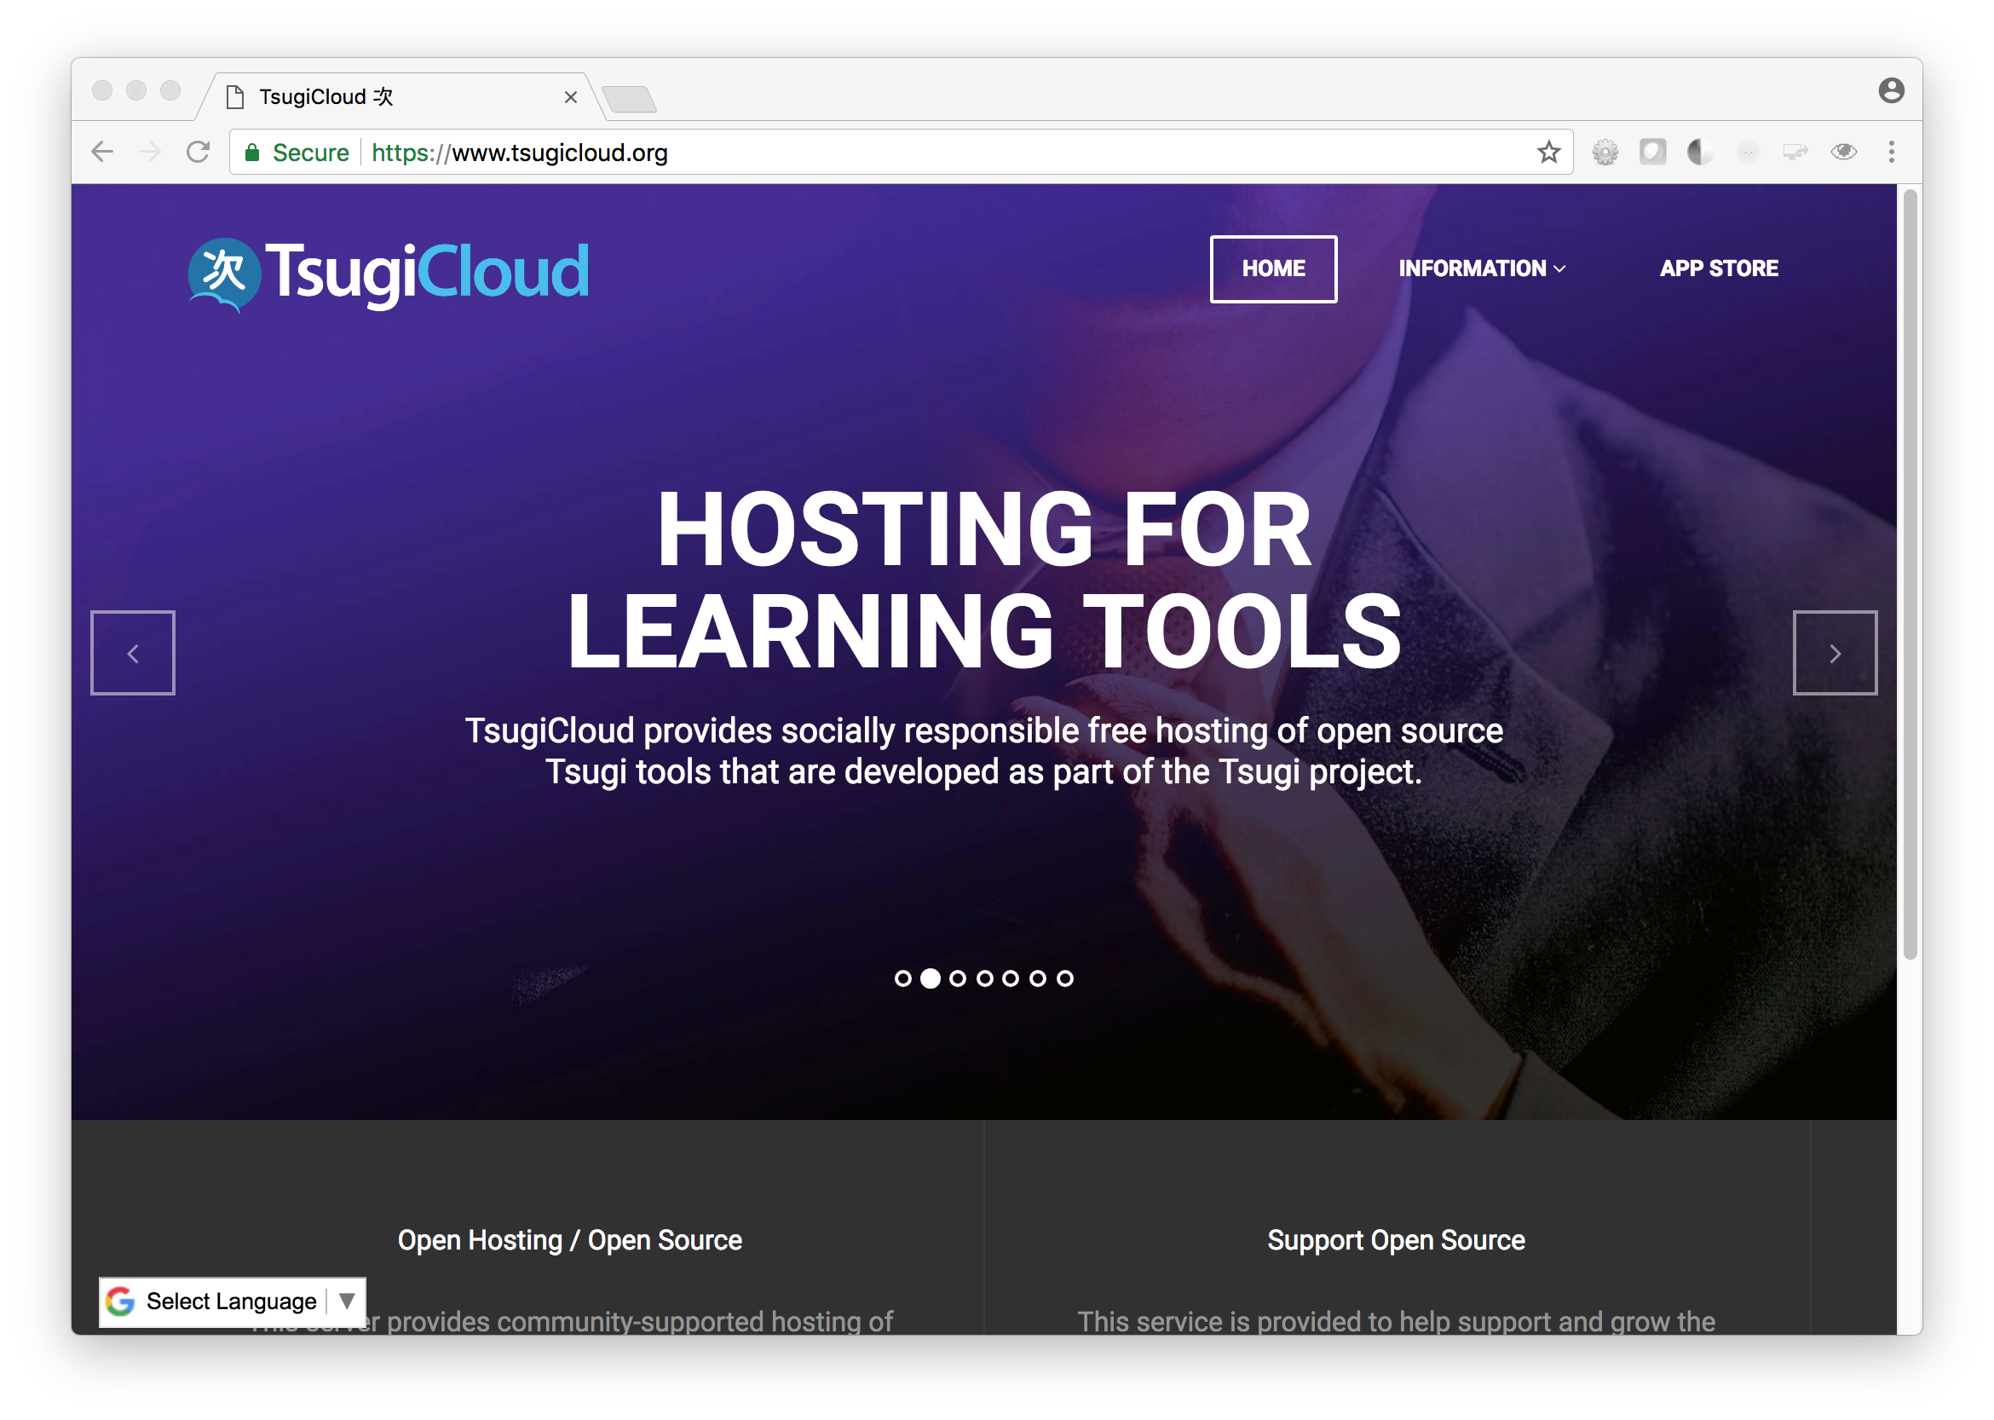

Slide 7
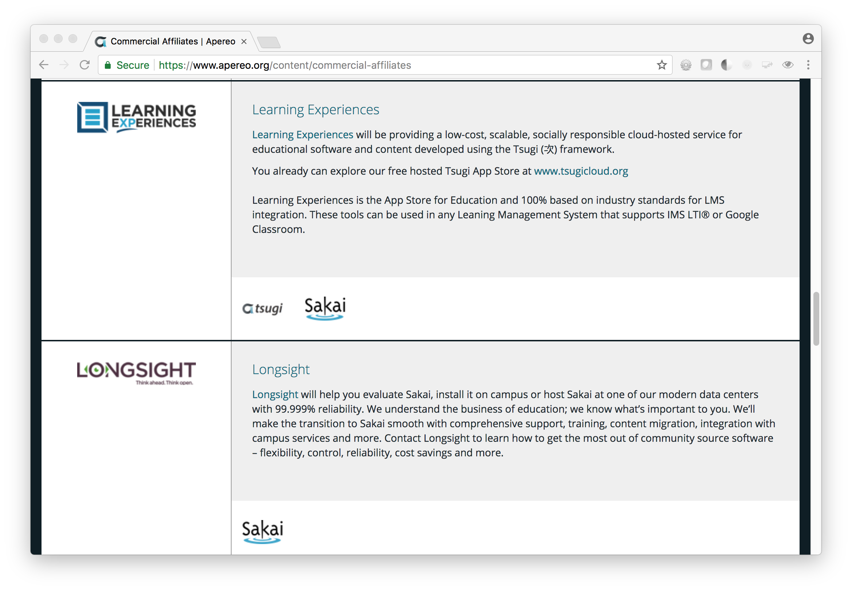

Slide 8


Slide 9
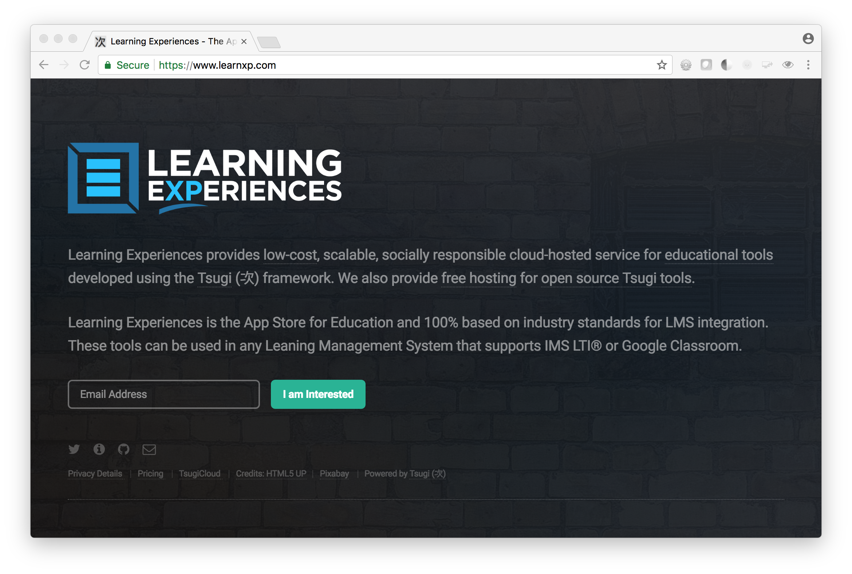

Slide 10
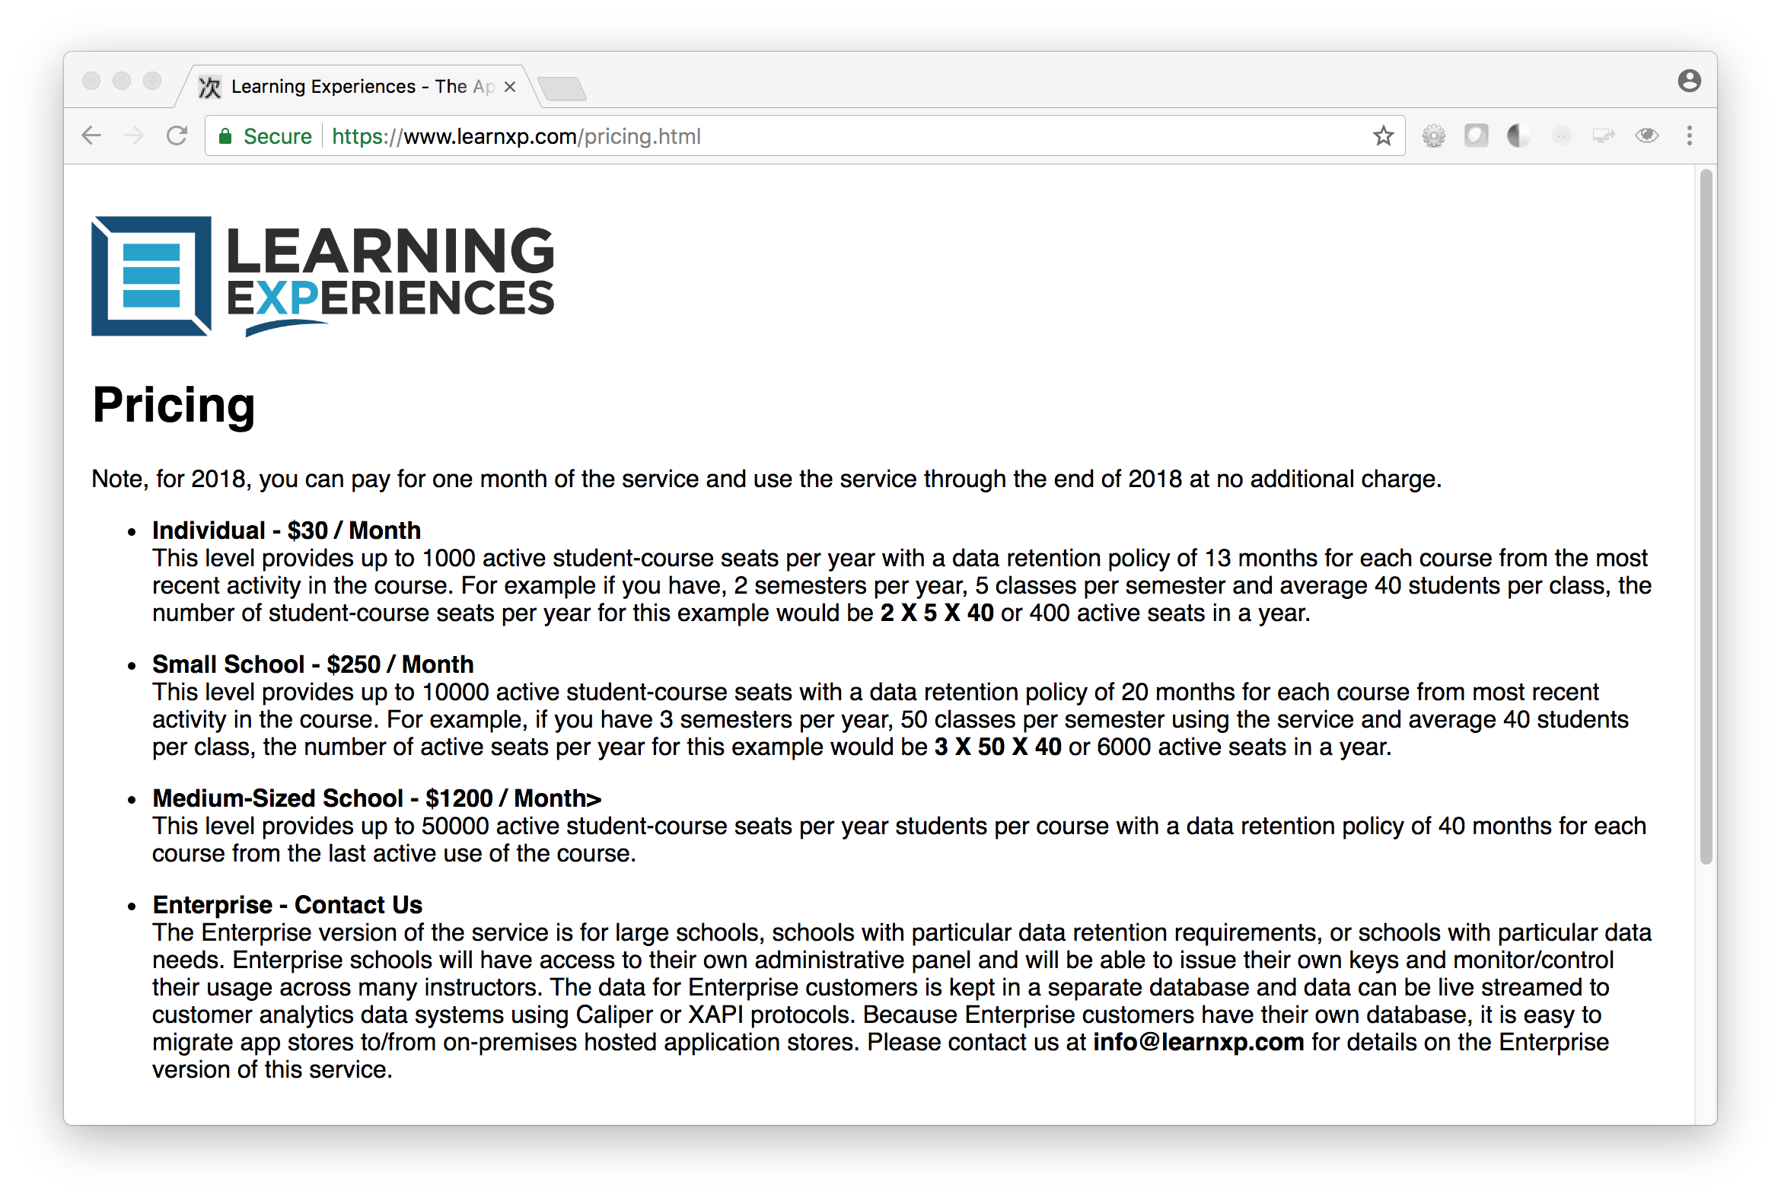

Slide 11
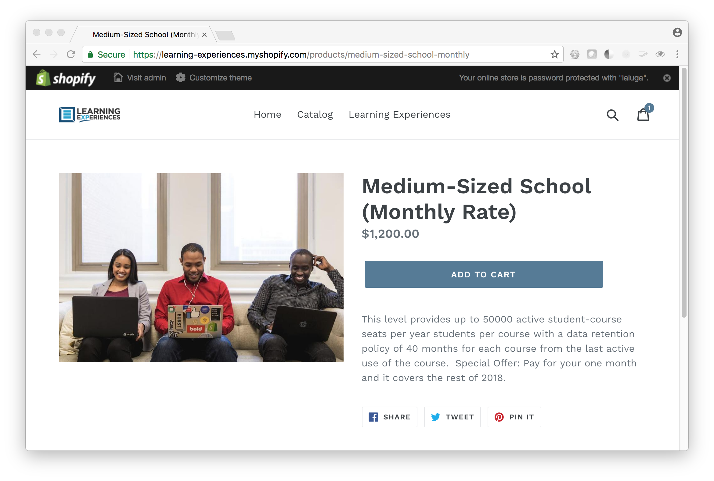

Slide 12
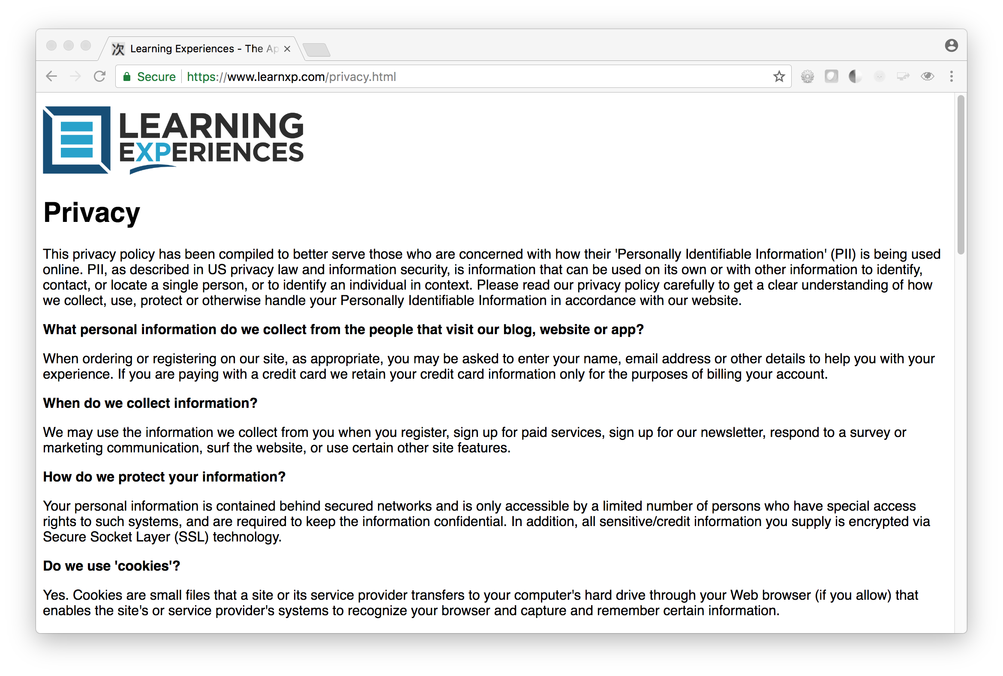

Slide 13

Radically Open Source
Cloud Recipes Free and Apache Licensed
https://github.com/tsugiproject/docker-php
https://github.com/tsugicloud/ami-sql
https://github.com/csev/sandbox
I want a locally owned commercial Tsugi Provider in every major county / region

Slide 14


